Slide 1

Federated Fair Recommendation with LLM-Based User Profiling
School of Computer Science And Engineering
P Manas (23BCE5076)
Vivaash Koundal (23BCE5095)
Varhade Advait Ravindrakumar (23BCE5098)
Guide Name:
Suganeshwari

Slide 2
Contents
Field of Work & Objectives
Introduction
Literature survey
Conclusions from the Literature Survey
Problem Definition (Objective & Scope)
Methodology/Work Plan (Chart)
Design standards & Realistic Constraints
Work done
Work to be done
Time line
References

Slide 3
Field of Work and
Objectives
Field of Work:
Privacy-Preserving Recommender Systems, Federated Learning and Fairness.
Objectives:
1. Adapt the SUPER framework to a federated setting (FedSUPER) to protect user data.
2. Integrate LLM-based user profiling to recover accuracy drops caused by federated sparsity.
3. Ensure original SUPER calibration guarantees (Rmse-PC) are strictly maintained.

Slide 4
Introduction
Recommender systems often suffer from popularity bias, overshadowing long-tail items. The SUPER framework effectively mitigates this by merging head and tail recommendations via user-specific blueprints. However, SUPER is centralized, creating privacy risks. Federated Learning solves privacy but degrades recommendation accuracy. This project integrates LLM semantic user profiles into FedSUPER to achieve both privacy and high accuracy.

Slide 5
Literature Survey
List the important and significant findings from the literature (Journal papers) pertaining to your work. (use following table)
Use max. of 3 slides.
S. No. | Paper Title | Journal Name | Publication Year | Important Findings
1 | SUPER: Smart User-centric Popularity Exposure Reduction... | IEEE Access | 2026 | Introduced blueprint merging for popularity bias; but it is centralized.
2 | Federated Neural Collaborative Filtering | Knowl.-Based Syst. | 2021 | Preserves privacy via local user embeddings; suffers from data sparsity.

Slide 6
Outcome of
Literature Survey
Research Gaps Identified:
No existing work provides a mathematically guaranteed popularity calibration (like SUPER) in a fully federated, privacy-preserving manner.
Traditional federated learning causes severe accuracy drops on long-tail items due to client-side data sparsity.
LLM semantic integration has not been explored as a mechanism to rescue accuracy specifically within the constraints of strict popularity-calibration blueprints.

Slide 7
Problem Definition
Objectives:
Implement a Federated SUPER (FedSUPER) baseline.
Integrate LLM profile semantics (Sentence-BERT) into the federated pipeline.
Evaluate models on the ML-1M dataset.
Scope of the Study:
Focuses on the MovieLens-1M dataset to evaluate implicit feedback recommendations.
Primary evaluation metrics: Recall@20 (for accuracy) and Rmse-PC (to validate calibration preservation).

Slide 8
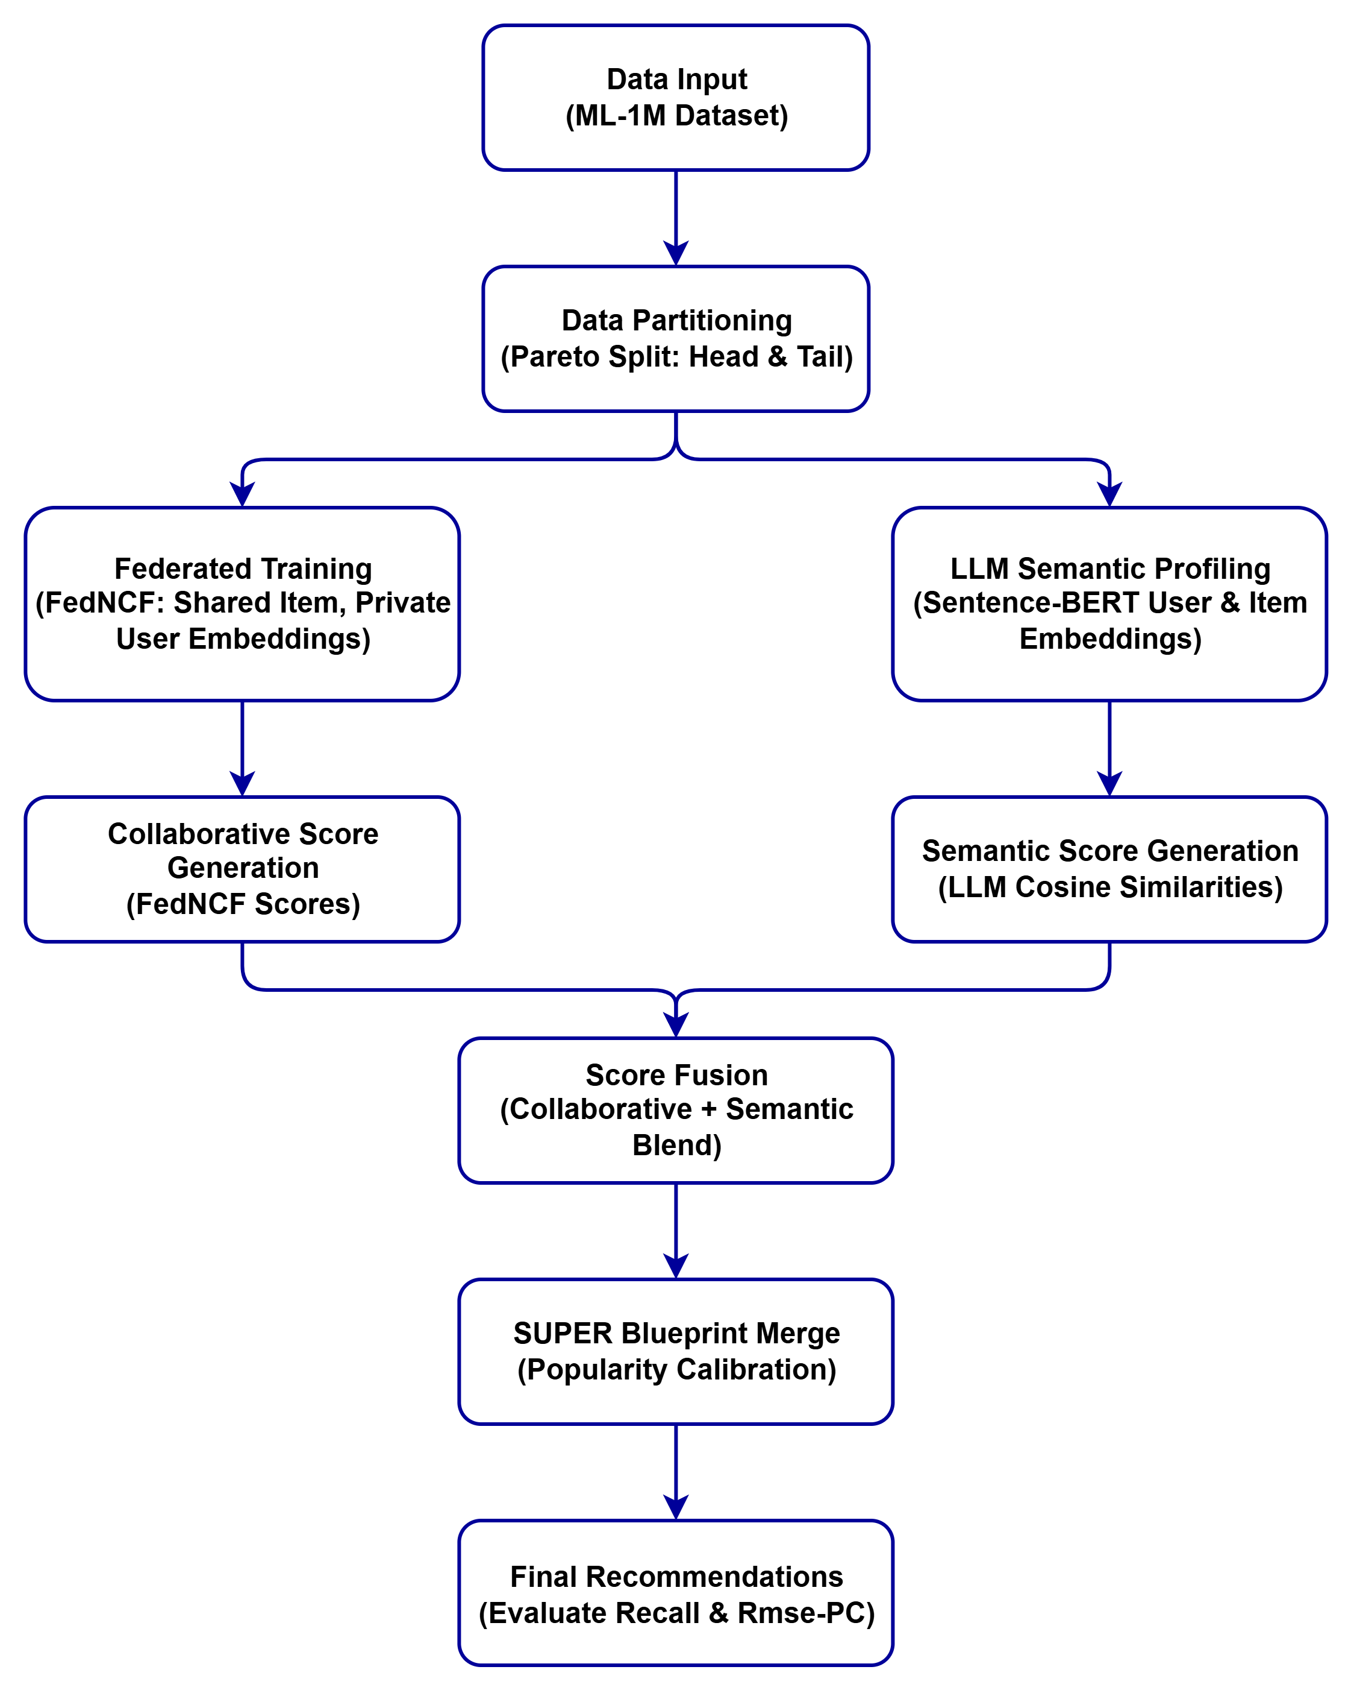
Methodology

Slide 9
Architecture

Slide 10
Realistic Constraints
Federated learning entails severe data sparsity on the client side, complicating long-tail learning.
Compute overhead for generating LLM embeddings locally on resource-constrained user devices (mitigated via lightweight MiniLM models).

Slide 11
Project Demonstration
Work Done:
- Centralized baselines (BPR-MF, SUPER) successfully implemented and validated.
- FedSUPER baseline evaluated. Proved that blueprint merges work perfectly in federated settings, maintaining perfect calibration (Rmse-PC = 0.055).
- LLM semantic profiling integrated into FedSUPER.
- Results: LLM-FedSUPER recovered 91% of the federated recall gap (Recall=0.037 vs centralized 0.038) while maintaining identical popularity calibration.
- Proven that SUPER's calibration is a property of the algorithm, invariant to the federated backbone.

Slide 12
Work to be done
Work to be done:
- Formal documentation of the privacy-utility trade-offs and composite FDN-A metrics.
- Finalizing the project report and drafting the research paper.
- Code cleanup, documentation, and preparation for open-source publication.

Slide 13
Time Line
- Phase 1: Literature review, dataset preparation, and environment setup.
- Phase 2: Centralized baseline implementation and FedNCF core.
- Phase 3: FedSUPER integration and LLM profiling.
- Phase 4: Final metric evaluation, reporting, and review preparation.

Slide 14
References
1. Yavru, S. et al. (2026). SUPER: Smart User-centric Popularity Exposure Reduction for Fair and Diverse Recommendations, IEEE Access.
2. Perifanis, V. et al. (2021). Federated Neural Collaborative Filtering, Knowledge-Based Systems.
3. Reimers, N. et al. (2019). Sentence-BERT: Sentence Embeddings using Siamese BERT-Networks, EMNLP.

